Slide 1
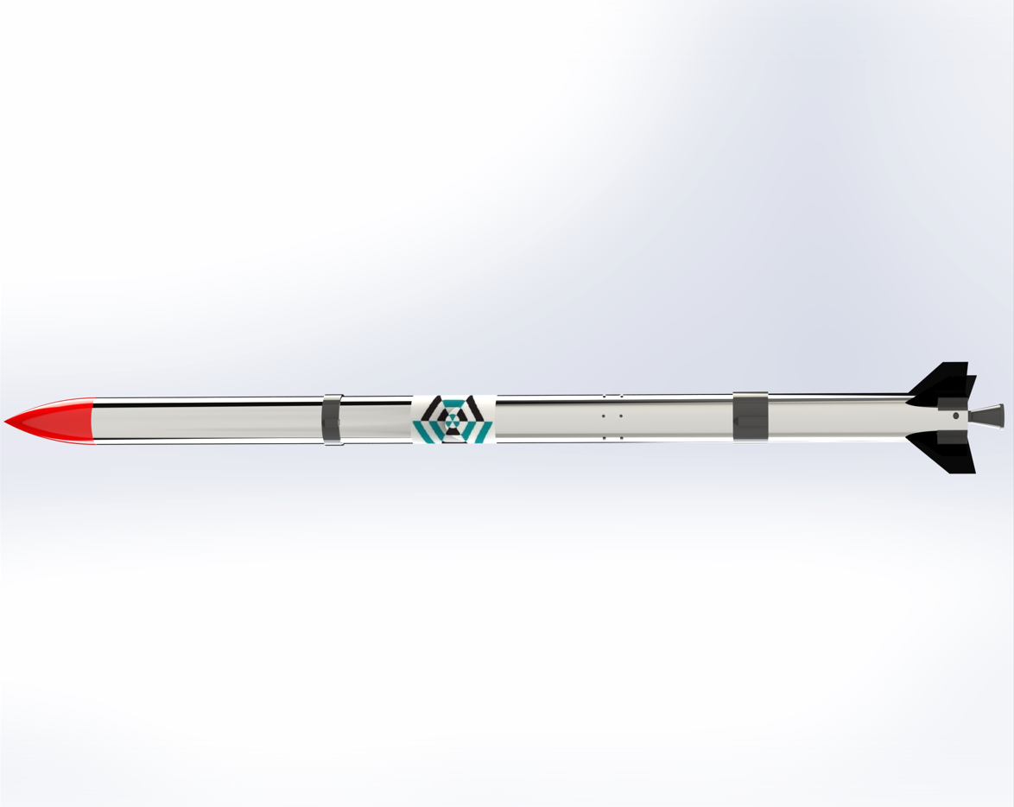
Progress Report: Nakuja N3
AIRFRAME TEAM • 05.04.2023

Slide 2
Overview
Recent Progress:
Progress on aluminium and fibreglass airframes
Yet to be finalised:
Fabrication of Fin Alignment Jig
Finalization of Aluminium and Fibreglass Body Tubes Fabrication
Fabrication of Parachute

Slide 3
Progress on fabrication of Airframes
We started sanding the fiberglass airframes in preparation for assembly
The aluminium airframe was almost complete but we hit a bump.

Slide 4
Challenges
Resolve
The longer Al. tube for the upper section was not rolled properly
The overlap was not well done causing problems during riveting
The tube was not concentric due to many post-rolling corrections
We resolved to splitting
the upper tube section into two
for easy rolling
Once finished on riveting
the remaining sections we’ll
assemble and check on continuity

Slide 5
Goals for the next week
Assembly of Aluminium and Fibreglass Body Tube
Test if all parts fit in as desired

Slide 6
The End.
Thank you for your time.

